Slide 1


Slide 2
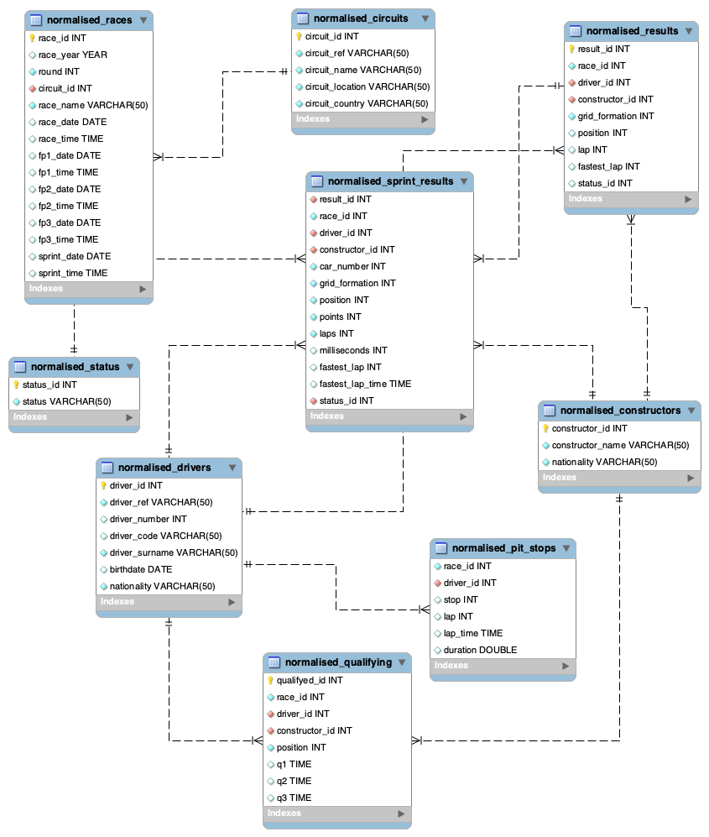
Normalisation of datasets, PK and FK

Slide 3
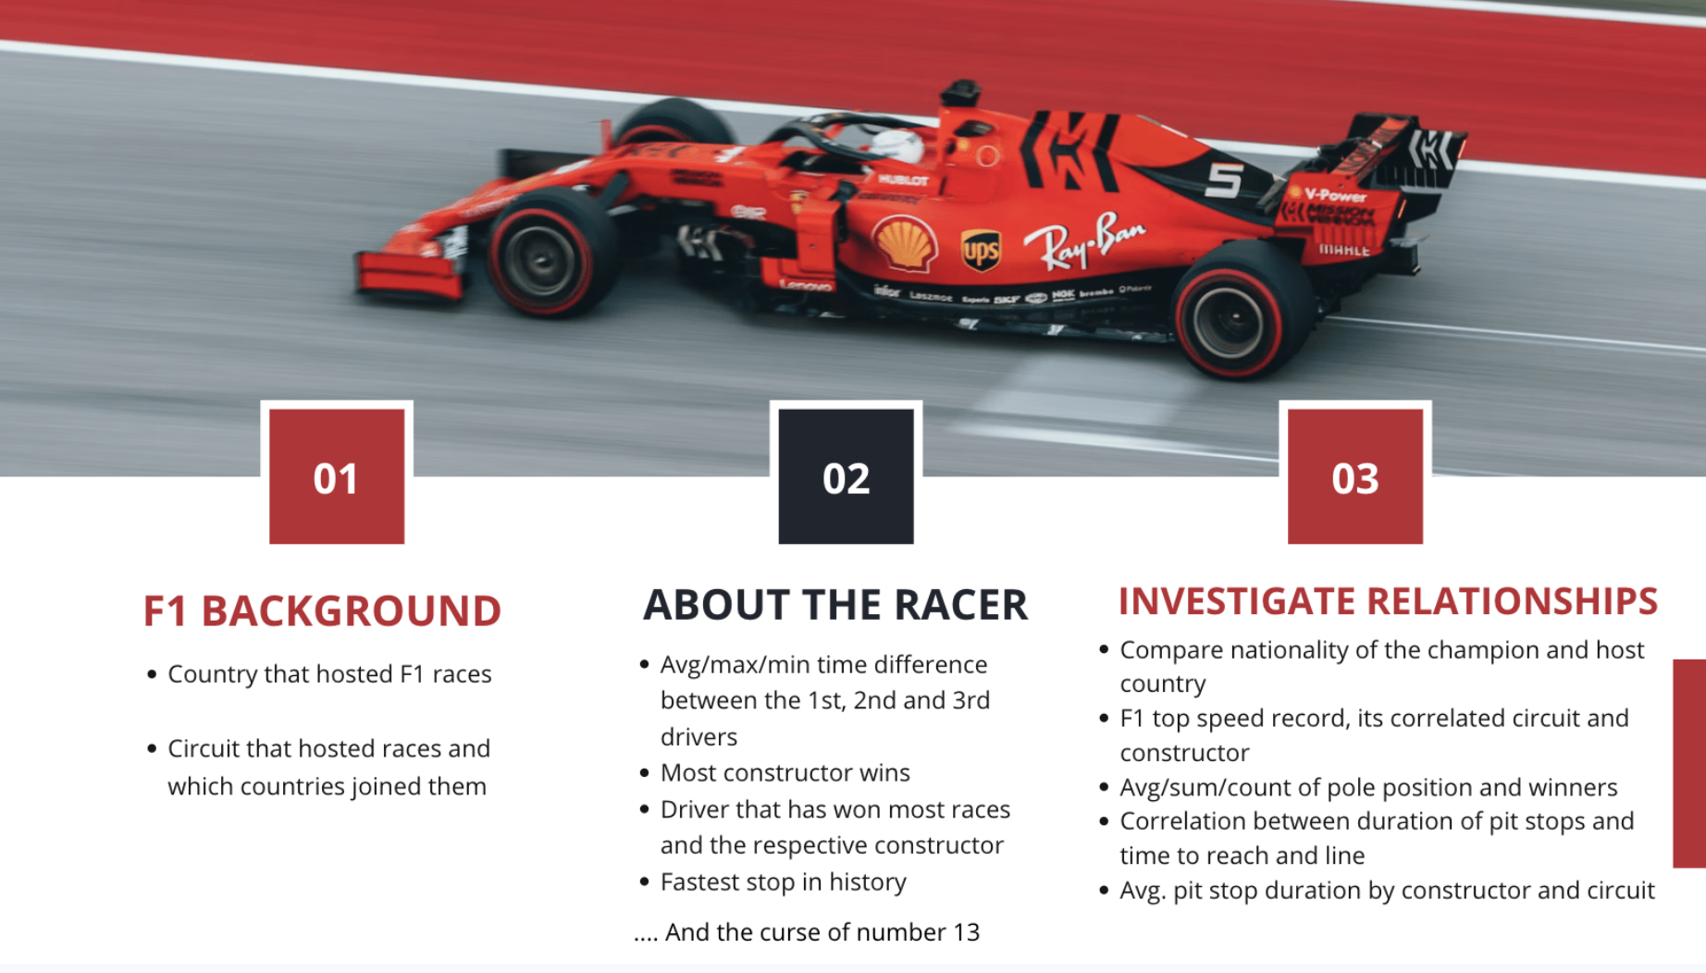

Slide 4
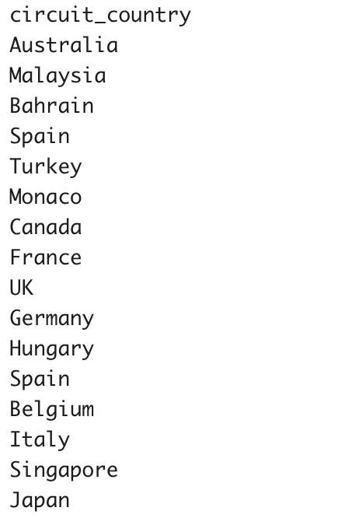
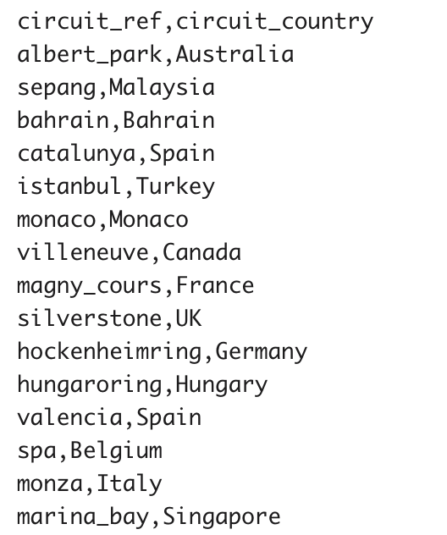
F1 BACKGROUND
01
Country that hosted F1 races
Circuits that hosted races and countries that joined
SELECT circuit_country
FROM normalised_circuits;
SELECT circuit_ref, circuit_country
FROM normalised_circuits;
Notes:
Note: not all data displayed since it’s too long

Slide 5
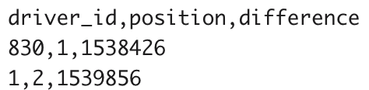
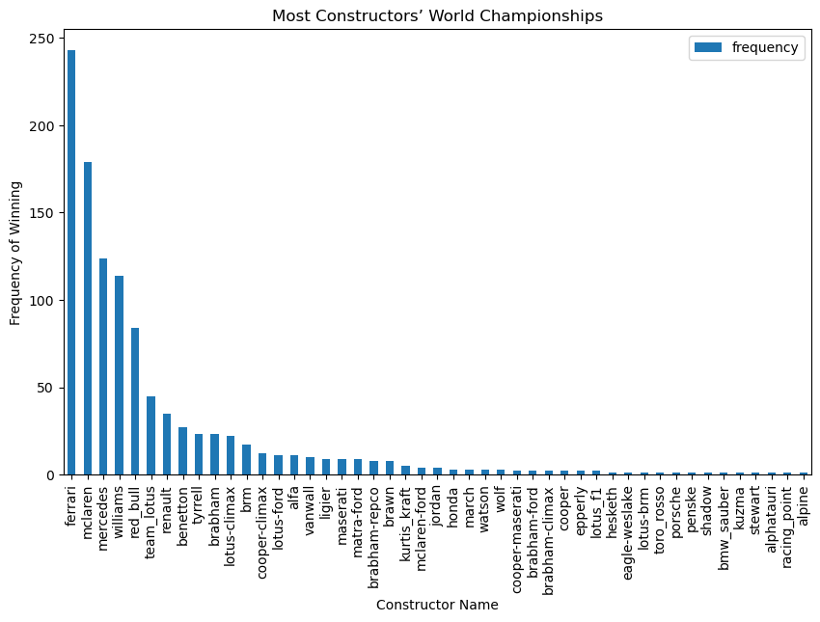
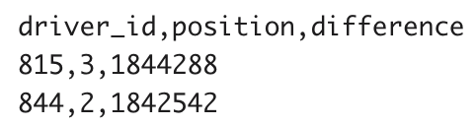
Fastest driver amongst first 3 positions
Constructor that has won the most races
SELECT driver_id, position, MIN(milliseconds) AS difference
FROM normalised_sprint_results
WHERE position BETWEEN 1 and 3
GROUP BY driver_id, position
ORDER BY MIN(milliseconds) ASC;
SELECT c.constructor_id, c.constructor_name
FROM normalised_constructors AS c
INNER JOIN(SELECT constructor_id, COUNT(constructor_id)FROM normalised_results WHERE position = 1 GROUP BY constructor_id ORDER BY COUNT(constructor_id) DESC LIMIT 1) AS v
ON c.constructor_id = v.constructor_id;
Slowest driver amongst first 3 positions
SELECT driver_id, position, MAX(milliseconds) AS difference
FROM normalised_sprint_results
WHERE position BETWEEN 1 and 3
GROUP BY driver_id, position
ORDER BY MAX(milliseconds) DESC;
Notes:
Note: not all data displayed since it’s too long

Slide 6
ABOUT THE RACER
02
Fastest pit stop ever
Driver that has won the most races and respective constructor
SELECT d.driver_surname, ps.duration, r.race_id, r.race_date, r.round, r.race_name
FROM normalised_pit_stops ps
LEFT JOIN normalised_drivers d ON ps.driver_id = d.driver_id
LEFT JOIN normalised_races r ON ps.race_id = r.race_id
WHERE ps.duration = (SELECT MIN(duration) FROM normalised_pit_stops);
SELECT d.driver_surname, c.constructor_name, r.race_year
FROM normalised_sprint_results AS sr
LEFT JOIN normalised_drivers AS d on sr.driver_id = d.driver_id
LEFT JOIN normalised_constructors AS c on sr.constructor_id = c.constructor_id
LEFT JOIN normalised_races AS r on sr.race_id = r.race_id
WHERE sr.position = 1
ORDER BY r.race_year;
driver_surname | duration | race_id | race_date | round | race_name
Maldonado | 12.897 | 858 | 2011-11-13 | 18 | Abu Dhabi Grand Prix
driver_surname | constructor_name | race_year
Verstappen | red_bull | 2021
Bottas | mercedes | 2021
Bottas | mercedes | 2021
Verstappen | red_bull | 2022
Verstappen | red_bull | 2022

Slide 7
INVESTIGATE RELATIONSHIPS
03
Compare the nationality of the 1st racers and the hosting country
F1 top fastest lap, its correlated circuit and its constructor
SELECT d.nationality, r.race_name, r.race_id
FROM normalised_sprint_results AS sr
LEFT JOIN normalised_drivers AS d
ON sr.driver_id = d.driver_id
LEFT JOIN normalised_races AS r ON sr.race_id = r.race_id
WHERE sr.position =1
ORDER BY d.driver_surname;
SELECT ns.fastest_lap_time, ns.milliseconds, c.circuit_name, co.constructor_name, ns.driver_id
FROM normalised_sprint_results AS ns
INNER JOIN normalised_circuits AS c
ON ns.driver_id = c.circuit_id
LEFT JOIN normalised_constructors AS co
USING (constructor_id)
WHERE ns.fastest_lap_time IS NOT NULL
AND ns.milliseconds IS NOT NULL
ORDER BY ns.fastest_lap_time LIMIT 1;
nationality | race_name | race_id
Finnish | Italian Grand Prix | 1065
Finnish | Sao Paulo Grand Prix | 1071
Dutch | British Grand Prix | 1061
Dutch | Emilia Romagna Grand Prix | 1077
Dutch | Austrian Grand Prix | 1084
fastest_lap_time | milliseconds | circuit_name | constructor_name | driver_id
01:09:01 | 1625506 | Albert Park Grand Prix Circuit | mercedes | 1

Slide 8
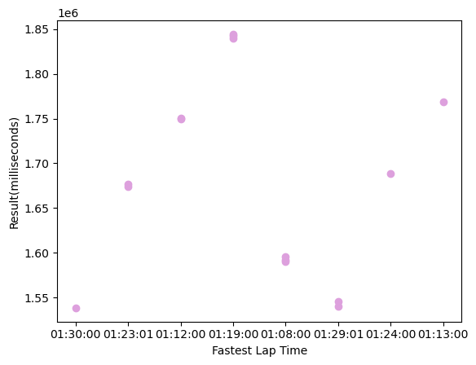
INVESTIGATE RELATIONSHIPS
Correlation between duration of pit stops and tie to win race/reach the end line
03
SELECT position,laps AS no_laps,
fastest_lap_time,
milliseconds AS result_milliseconds,
driver_id, constructor_id, race_id
FROM normalised_sprint_results
WHERE position BETWEEN 1 AND 3
ORDER BY position ASC;
The avg of the pole position (q1, q2, q3) and the winners
SELECT sec_to_time(AVG(TIME_TO_SEC(q1))) AS average_q1, sec_to_time(STD(TIME_TO_SEC(q1))) AS std_q1,
sec_to_time(AVG(TIME_TO_SEC(q2))) AS average_q2, sec_to_time(STD(TIME_TO_SEC(q2))) AS std_q2,
sec_to_time(AVG(TIME_TO_SEC(q3))) AS average_q3, sec_to_time(STD(TIME_TO_SEC(q3))) AS std_q3
FROM normalised_qualifying;
average_q1 | std_q1 | average_q2 | std_q2 | average_q3 | std_q3
01:28:14.7588 | 00:15:55.999012 | 01:25:08.3090 | 00:18:59.345005 | 01:25:08.3090 | 00:18:59.345005
--Find the average and the std of the winners' pole positions — -
SELECT sec_to_time(AVG(TIME_TO_SEC(q1))) AS average_q1, sec_to_time(STD(TIME_TO_SEC(q1))) AS std_q1,
sec_to_time(AVG(TIME_TO_SEC(q2))) AS average_q2, sec_to_time(STD(TIME_TO_SEC(q2))) AS std_q2,
sec_to_time(AVG(TIME_TO_SEC(q3))) AS average_q3, sec_to_time(STD(TIME_TO_SEC(q3))) AS std_q3
FROM normalised_qualifying
WHERE position = 1;
average_q1 | std_q1 | average_q2 | std_q2 | average_q3 | std_q3
01:28:14.7588 | 00:15:55.999012 | 01:25:08.3090 | 00:18:59.345005 | 01:25:08.3090 | 00:18:59.345005

Slide 9
INVESTIGATE RELATIONSHIPS
The average pit stop by circuit
03
SELECT ROUND(AVG(ps.duration),2) AS avg_pit_stop, c.circuit_id AS circuit_id, c.circuit_name, c.circuit_location, c.circuit_country, races.race_name
FROM normalised_pit_stops AS ps
INNER JOIN normalised_circuits AS c
ON ps.driver_id = c.circuit_id
LEFT JOIN normalised_races AS races
ON ps.driver_id = races.race_id
GROUP BY c.circuit_id, races.circuit_id, c.circuit_name, c.circuit_location, c.circuit_country, races.race_name
ORDER BY c.circuit_country ASC
LIMIT 3;
The average pit stop duration by each constructor in each year
SELECT ROUND(AVG(duration), 2) AS avg_pit_stop_duration, c.constructor_name, races.race_year
FROM normalised_pit_stops AS ps
INNER JOIN normalised_constructors AS c
ON ps.driver_id = c.constructor_id
LEFT JOIN normalised_races AS races
ON ps.race_id = races.race_id
GROUP BY c.constructor_name,races.race_year
ORDER BY c.constructor_name ASC LIMIT 6;
avg_pit_stop | circuit_id | circuit_name | circuit _location | circuit_country | race_name
23.48 | 1 | Albert Park Grand Prix Circuit | Melbourne | Australia | Australian Grand Prix
23.27 | 3 | Bahrain International Circuit | Sakhir | Bahrain | Chinese Grand Prix
23.72 | 13 | Circuit de Spa- Francorchamps | Spa | Belgium | Italian Grand Prix
avg_pit_stop_duration | constructor_name | race_year
26.86 | ags | 2011
25.08 | ags | 2012
23.02 | bar | 2011
23.91 | bar | 2013
25.79 | bar | 2014
24.62 | benetton | 2011

Slide 10
The curse of number 13*
*Formula 1 has banned the number 13. There is also no garage with the number 13 and, previously, when numbers were assigned based on constructors' position in the standings, teams avoided that number.
Why? Because historically, whoever has used 13 in F1 has finished badly. This number records two deaths in a row in 1925 (Paul Torchy) and 1926 (Giulio Masetti).
In recent history, four riders have tried this number and it hasn't gone well: fires, dropouts, failures to qualify for races...
The closest case is that of Pastor Maldonado. The Venezuelan used the 13 in his Lotus during the 2014 and 2015 seasons, and retired from F1 with almost more DNFs/dropouts than points in those two seasons.
03
-- >Does number 13 lost the most races?
SELECT *
FROM normalised_sprint_results
WHERE car_number = 13; -- Nobody use car number 13 in this dataset
SELECT car_number
FROM normalised_sprint_results
WHERE position = 20;
-- >Does number 13 have more accidents/disqualify than other racers?
car_number
11
10
9
24
14
SELECT sr.car_number, sr.constructor_id, sr.driver_id, s.status
FROM normalised_sprint_results sr
RIGHT JOIN normalised_status s
ON sr.status_id = s.status_id
WHERE s.status_id = 2
OR s.status_id = 3
OR s.status_id = 4
OR s.status_id = 73
OR s.status_id = 82;
car_number | constructor_id | driver_id | status
NULL | NULL | NULL | Disqualified
10 | 213 | 842 | Accident
NULL | NULL | NULL | Collision
NULL | NULL | NULL | Injured
NULL | NULL | NULL | Injury

